Slide 1







Trends in Technology Usage and Future Preferences
Yuchen Li
Nov. 2nd. 2024

Slide 2



OUTLINE
Executive Summary
Introduction
Methodology
Results
Visualization – Charts
Dashboard
Discussion
Findings & Implications
Conclusion
Appendix

Slide 3

EXECUTIVE SUMMARY
Overview of current technology usage trends among developers
Insights into future technology preferences based on survey data
Top programming languages and databases in use today
Preferred platforms and frameworks.
Demographic insights (age, education level)
Analysis of how trends may impact future development skills
Key findings from interactive dashboards
Implications for stakeholders and future predictions

Slide 4

INTRODUCTION
Purpose of analyzing current and future tech preferences
Understanding skill demand in the job market
Data collected from multiple sources (APIs, web scraping)
Visualizations created for clearer insights
Dashboard highlights key insights for stakeholders
Project aim to guide tech and education decisions

Slide 5

METHODOLOGY
Data collection using APIs & web scraping for job postings and tech preferences
Data wrangling and cleaning processes
Exploratory data analysis to identify trends
Visualization tools and techniques used
Creation of interactive dashboards in Cognos
Filtering top trends for actionable insights

Slide 6
RESULTS

Slide 7
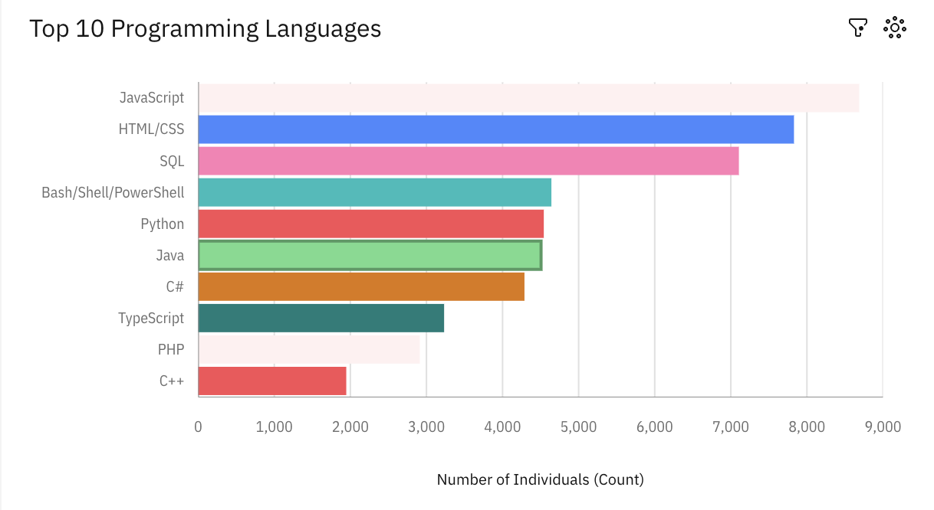
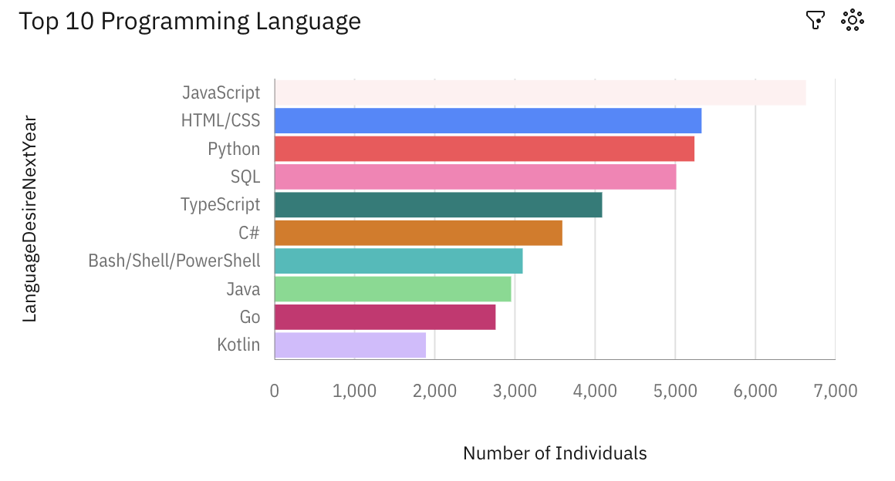
PROGRAMMING LANGUAGE TRENDS
Current Year
Next Year

Slide 8
PROGRAMMING LANGUAGE TRENDS - FINDINGS & IMPLICATIONS
Findings
JavaScript, HTML/CSS, SQL, Python, and Java are currently the most used languages.
Python and TypeScript show high interest for future learning.
C# and Go are emerging as preferred languages for upskilling.
Implications
Employers may need to expand hiring for Python and TypeScript skills.
Education programs could emphasize training in trending languages.
Language diversity points to a broad tech stack requirement in companies.

Slide 9
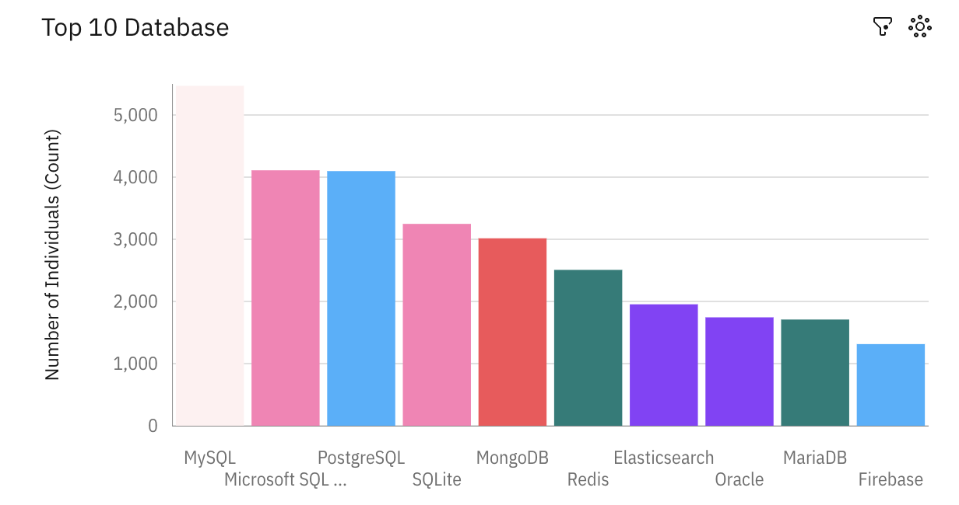
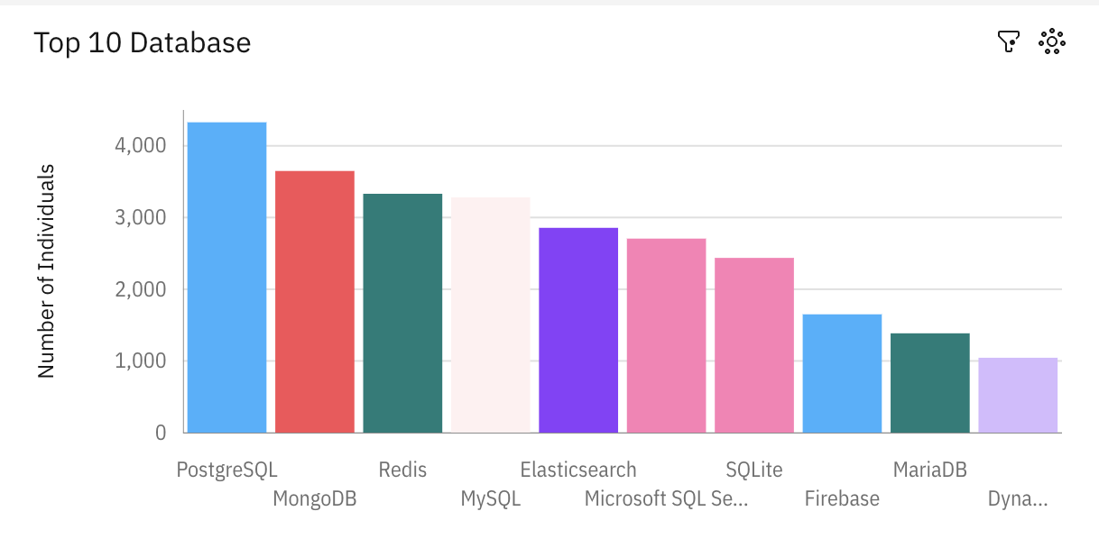
DATABASE TRENDS
Current Year
Next Year

Slide 10
DATABASE TRENDS - FINDINGS & IMPLICATIONS
Findings
MySQL, PostgreSQL, and MongoDB are highly used databases.
PostgreSQL and Redis are popular choices for future learning.
Relational databases remain crucial, but NoSQL databases are growing.
Implications
Employers should expect a rise in demand for PostgreSQL expertise.
SQL and NoSQL skills should be balanced in training programs.
Database preferences indicate a shift towards cloud-based, flexible solutions.

Slide 11

DASHBOARD
<The GitHub link of the Cognos/Looker Studio dashboard goes here.>

Slide 12
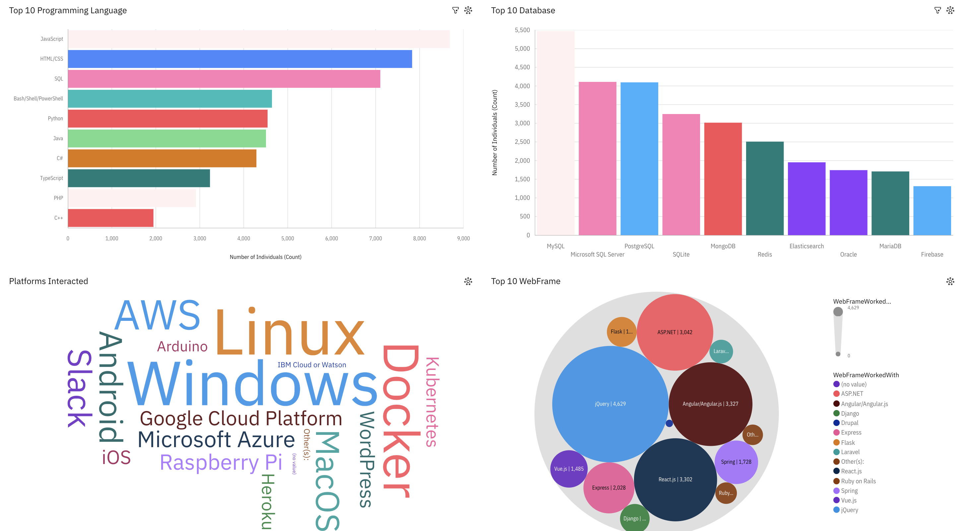
DASHBOARD TAB 1
Screenshot of dashboard tab 1 goes here

Slide 13
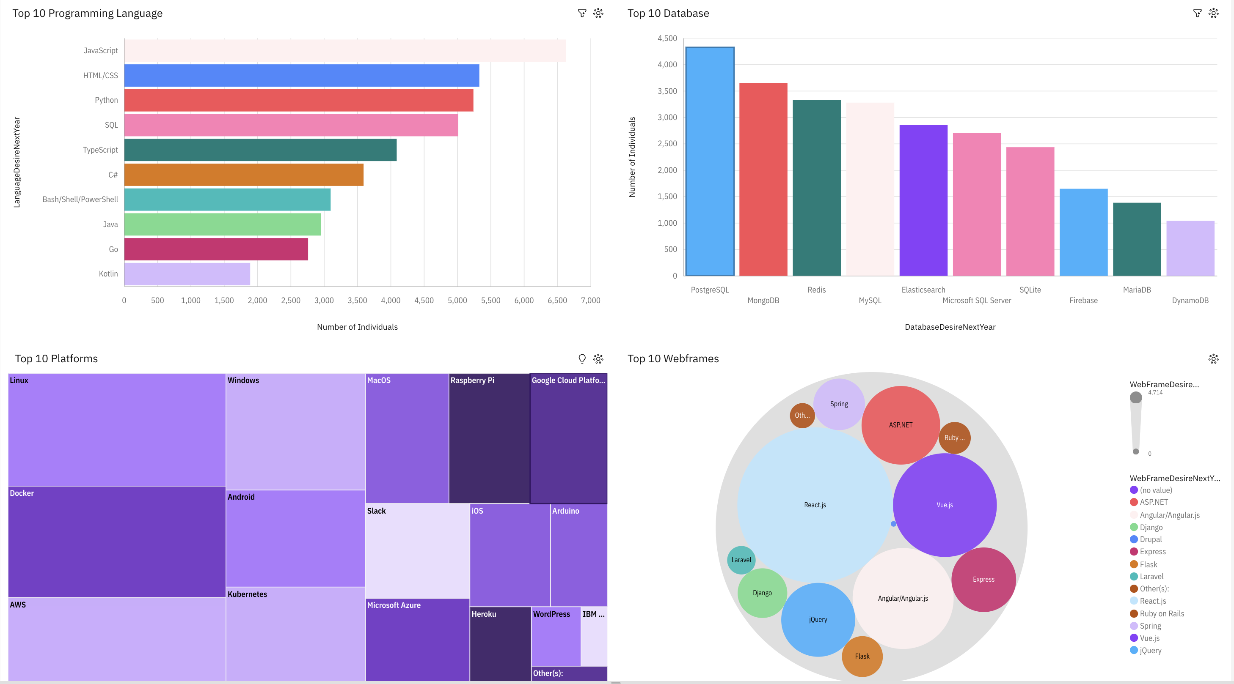
DASHBOARD TAB 2
Screenshot of dashboard tab 2 goes here

Slide 14
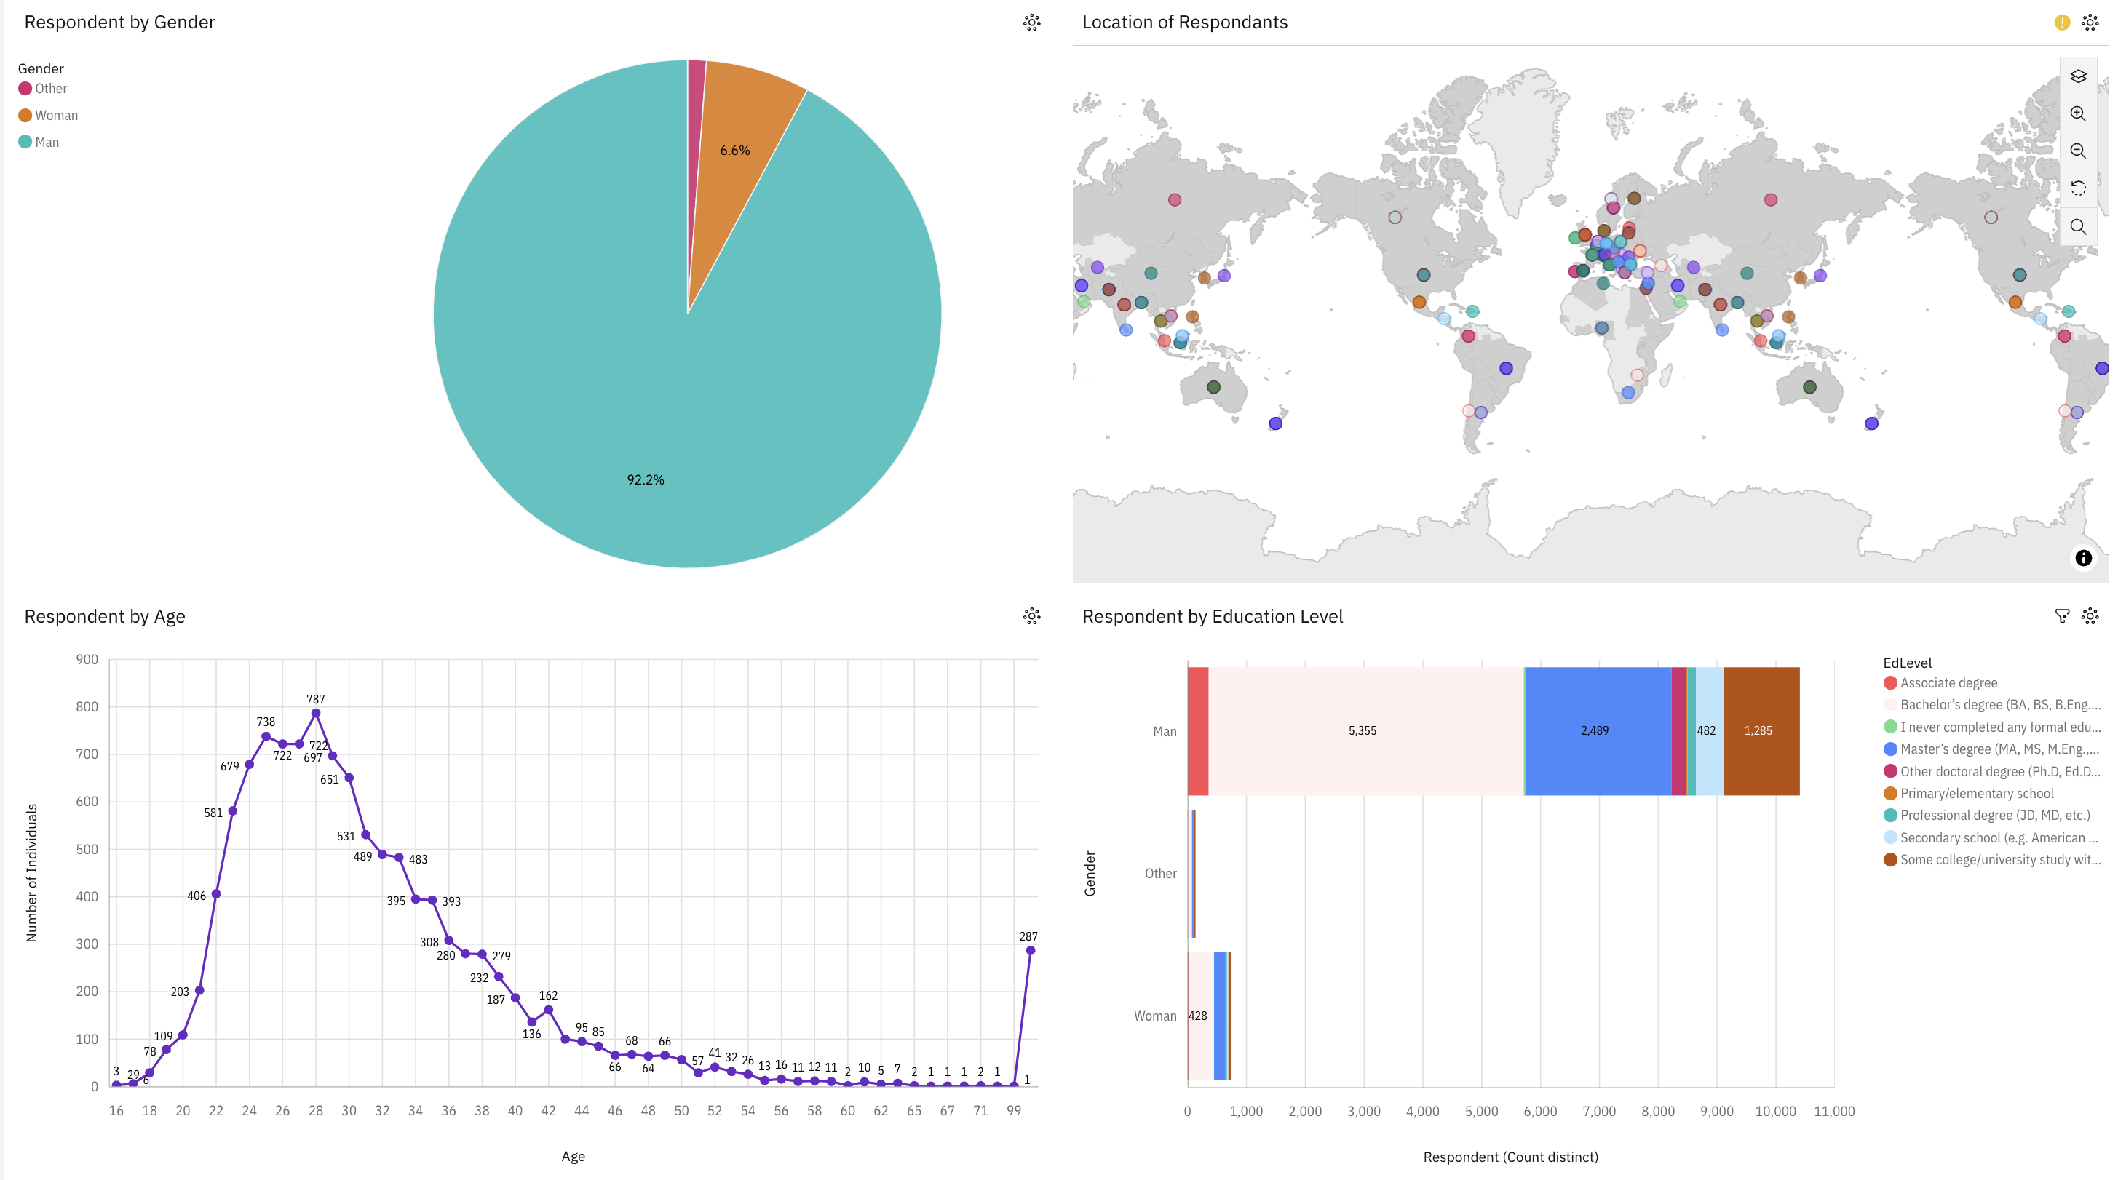
DASHBOARD TAB 3
Screenshot of dashboard tab 3 goes here

Slide 15
DISCUSSION

Slide 16
OVERALL FINDINGS & IMPLICATIONS
Findings
JavaScript and Python remain dominant in programming, with SQL as a foundational skill.
PostgreSQL is a growing database choice for future development.
Linux, Docker, and cloud platforms (AWS, GCP) are popular among developers.
Implications
Development and training programs should focus on these popular tools.
Employers should align their hiring to match these tech trends.
Educational institutions can use this data to adjust curricula.

Slide 17

CONCLUSION
Technology preferences reflect evolving skill needs in the industry.
The shift towards Python, PostgreSQL, and cloud platforms is evident.
Dashboards provide actionable insights for tech education and recruitment.
Future work could include tracking changes year-over-year.

Slide 18

APPENDIX

Slide 19
JOB POSTINGS

Slide 20
POPULAR LANGUAGES

